Slide 1
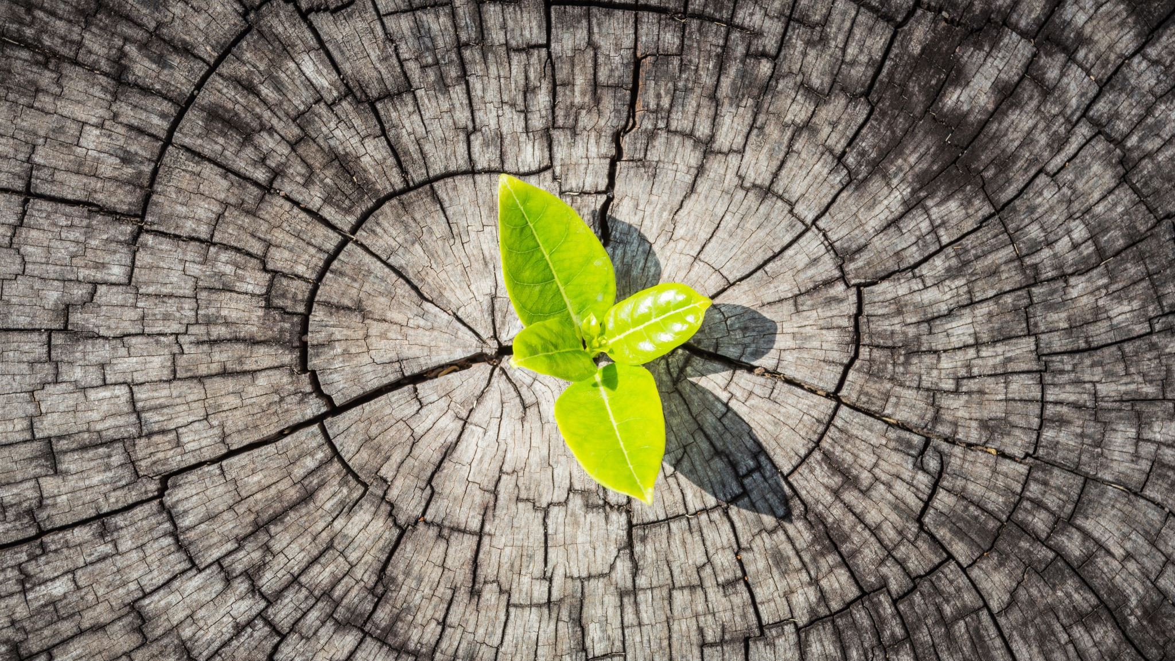
PLANT DISEASE CLASSIFICATION
DURGA VENKATA PHANINDRA KUMAR MULAMREDDY
SAI RUTHVIK ANANTAPALLI
RANADEEP REDDY GURRAM

Slide 2
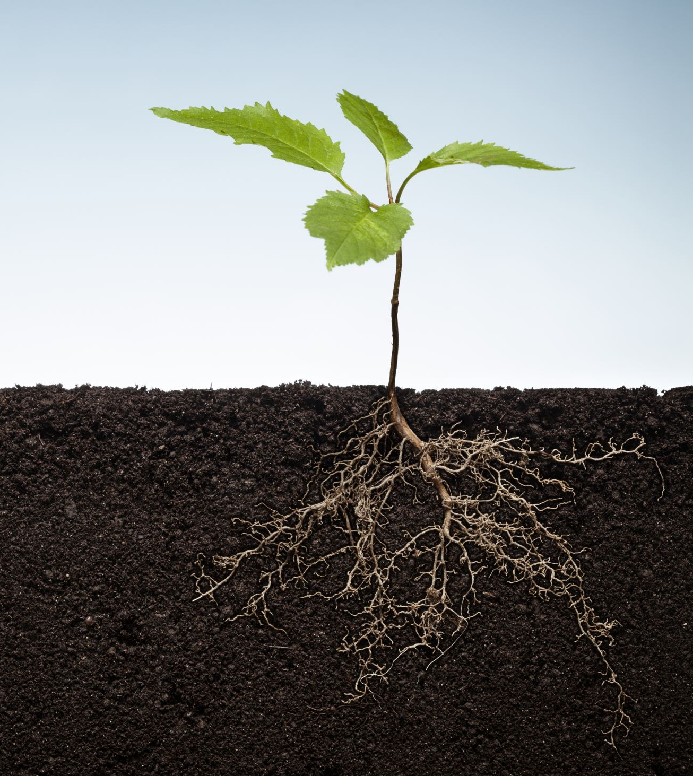
Problem Statement
The goal of this project is to develop a robust plant disease classification model for potatoes using Convolutional Neural Networks (CNN) and Residual Networks (ResNet). The primary objective is to accurately identify the presence of various diseases in potato plants from images.
Plant diseases pose significant threats to agricultural production and food security worldwide.
Identifying and diagnosing plant diseases manually can be time-consuming and prone to errors.
The objective is to build a plant disease classification model capable of distinguishing between healthy and diseased potato plants.
The two diseases of the potatoes are the early blight disease caused by the fungus and the late blight disease caused by micro-organisms.

Slide 3
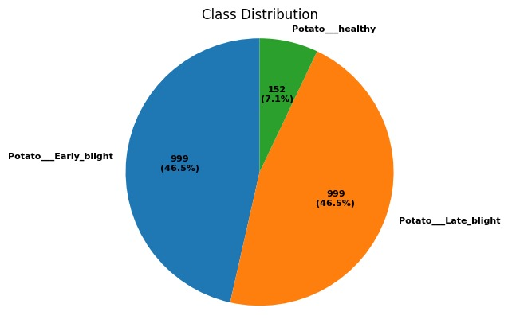
Data Set overview
The link of the data set is from Kaggle it is https://www.kaggle.com/datasets/arjuntejaswi/plant-village
The dataset consists of a collection of images of potato plants affected by different diseases and healthy potato plants.
Each image is labeled with the corresponding disease class, such as "Potato___Early_blight," "Potato___Late_blight," and "Potato___healthy.“

Slide 4

Splitting the data and Model Training
The dataset consists of images which are categorized into 3 classes.
The split ratios are as follows:
Training set: 70% of the dataset
Validation set: 15% of the dataset
Test set: 15% of the dataset
Three deep learning models, CNN, ResNet and VGG are used, which are utilized for plant disease classification.
All the models are trained using the training dataset.
Training is performed for 25 epochs for each model.
The purpose of the validation dataset is to assess the model's performance during training.
The models are validated on the validation dataset at the end of each epoch.
Losses and accuracies of both the training and validation sets are computed and monitored.
The aim is to observe improvement in model accuracy with each successive epoch.

Slide 5
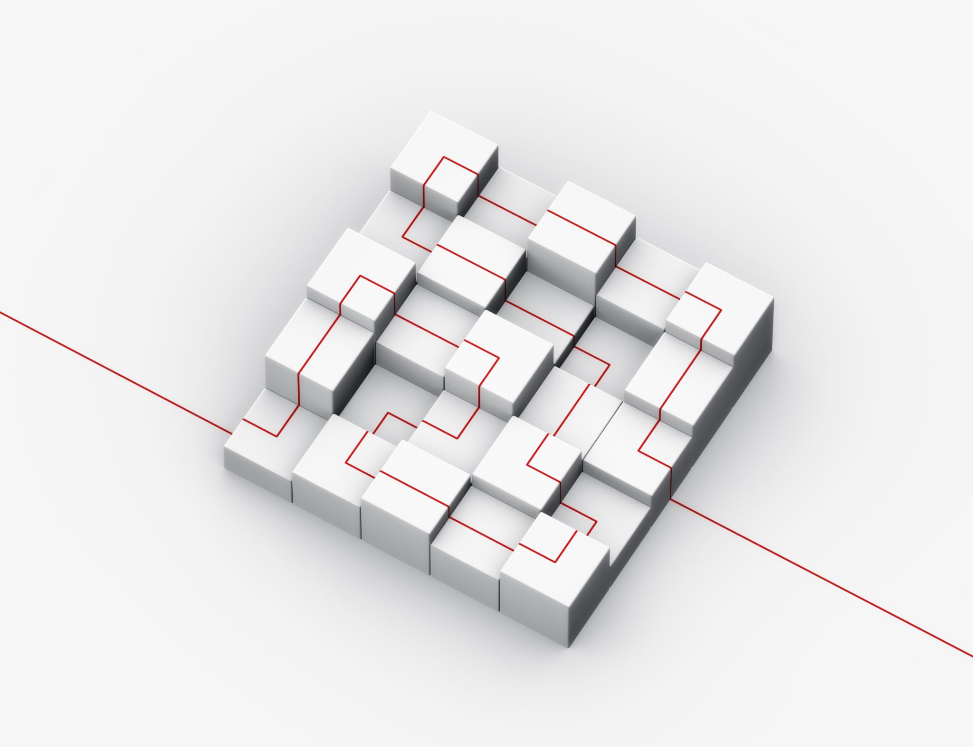
Accuracy of Models on Test Dataset
The three model’s architectures used in the classification of the problem are:
CNN(Convolutinal Neural Network) built by 15 layers
RESNET(Residual Network) built by 33 layers
VGG (Visual Geometry Group) built by 26 layers
The accuracy and the losses of all the models on the test data are:
CNN loss for the test data is 0.1234 and the accuracy is 0.9545
RESNET loss for the test data is 0.0668 and the accuracy is 0.9773
VGG loss for the test data is 0.8653 and the accuracy is 0.4233

Slide 6
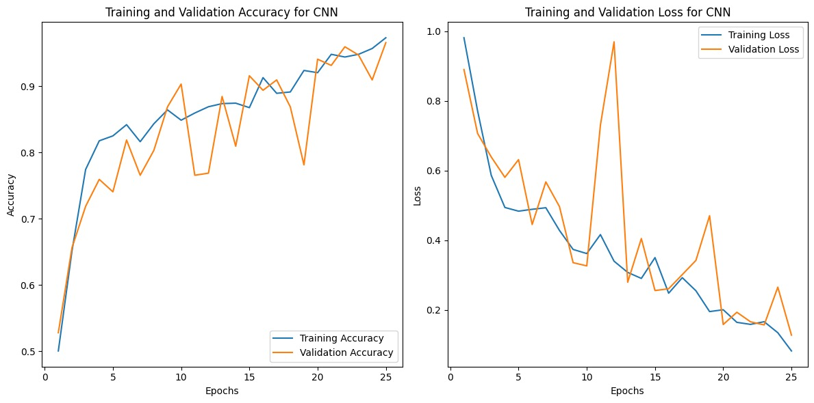
Training and Validation Accuracy and Loss of CNN

Slide 7
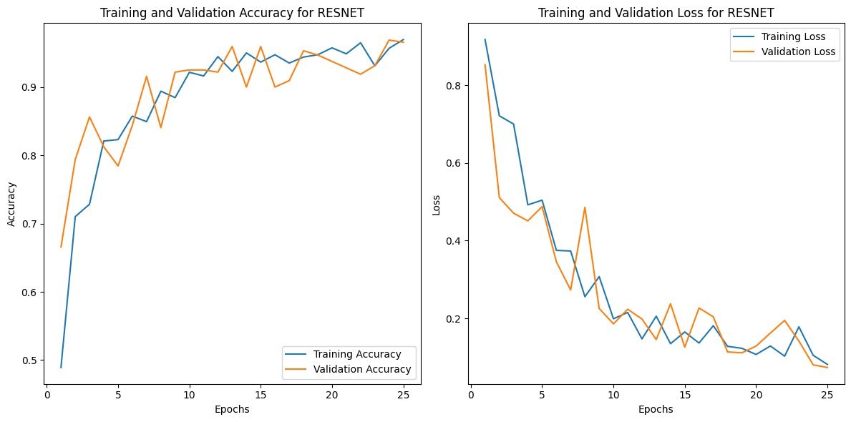
Training and Validation Accuracy and Loss of RESNET

Slide 8
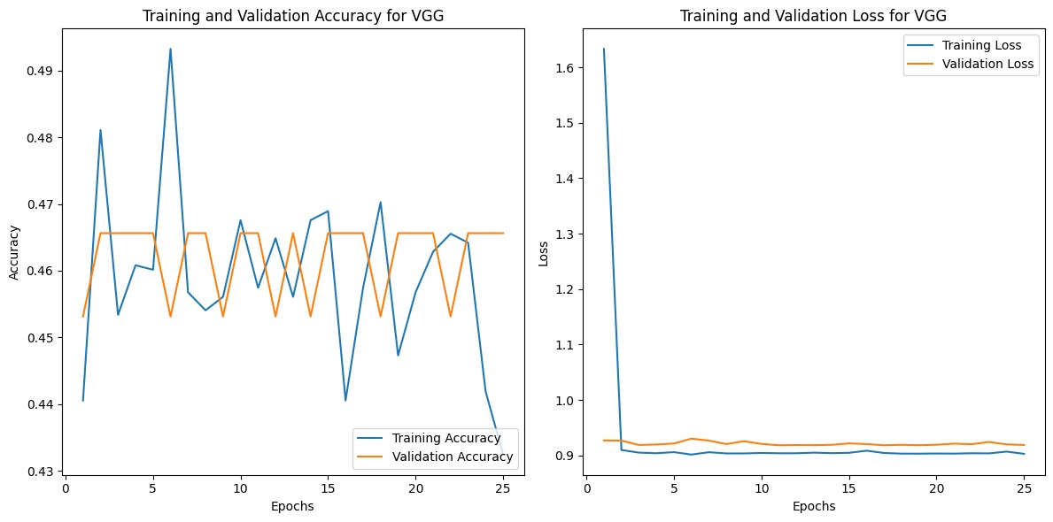
Training and Validation Accuracy and Loss of VGG

Slide 9
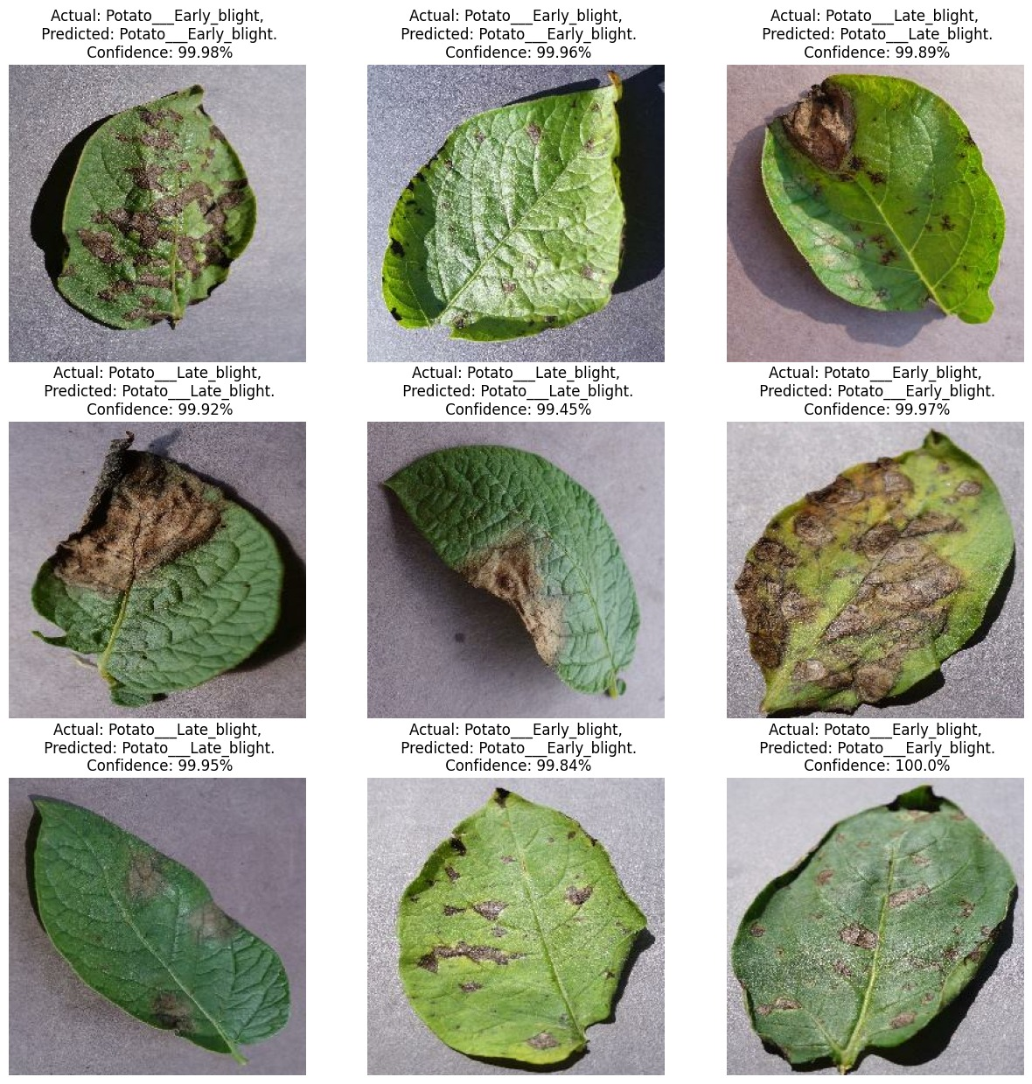
Predictions of the CNN Model on the test dataset

Slide 10
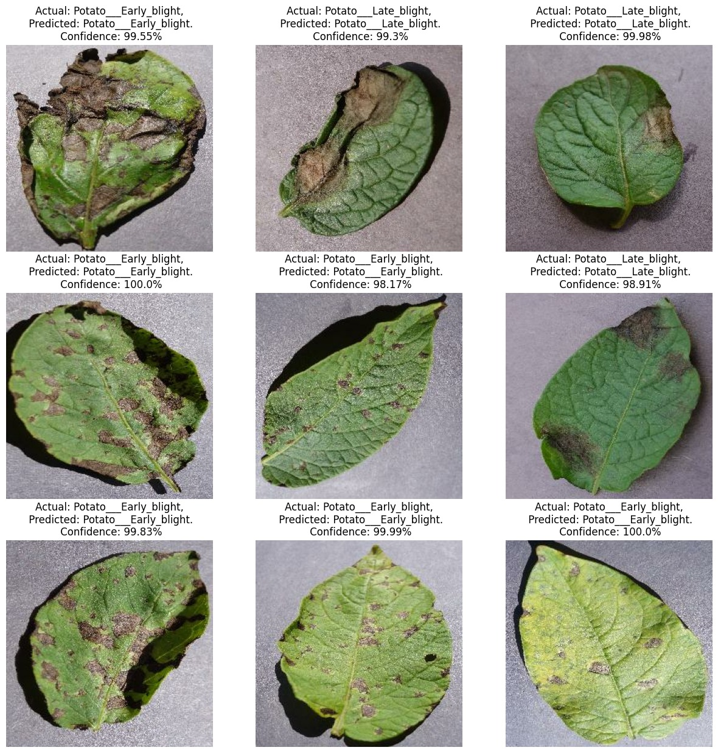
Predictions of the RESNET Model on the test dataset

Slide 11
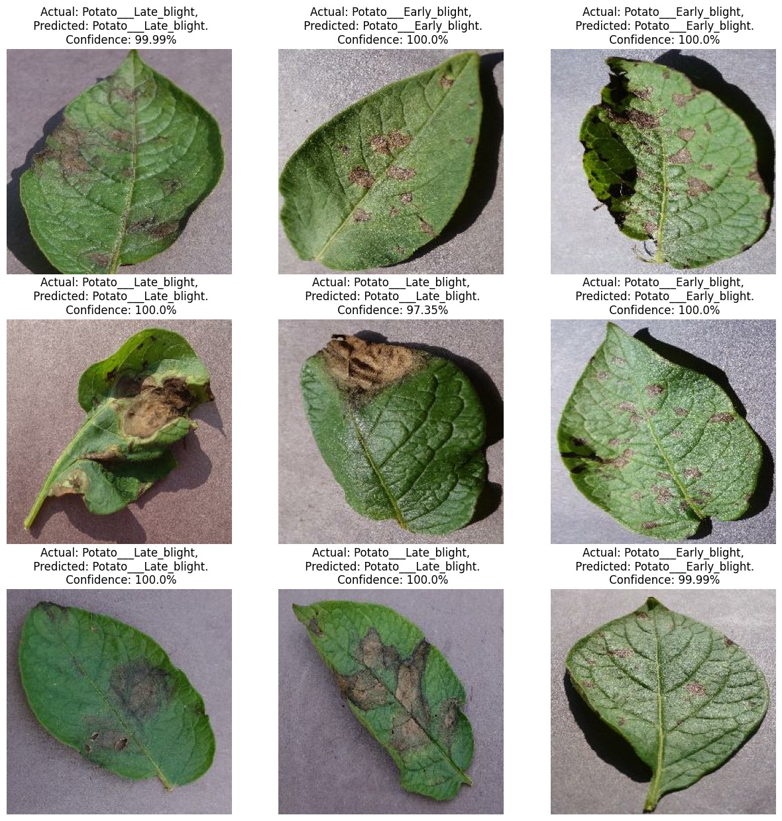
Predictions of the VGG Model on the test dataset

Slide 12
Conclusions and Results
Based on the comparisons of the two models the RESNET model performed better compared to the CNN model and VGG model with the more accuracy by testing it on the test dataset.
ResNet outperform CNN and VGG by enabling deeper architectures, resolving vanishing gradients, and achieving state-of-the-art performance in image tasks.
The loss score of the trained CNN and VGG is more compared to the Resnet model on the test dataset.
The confidence level and the probability predictions of the CNN Model is better in all the predictions.

Slide 13

Future Goals
Deployment of trained models for real-world applications.
Web and mobile application development planned for farmers' use.
User-friendly interface for uploading images of plant leaves.
Processing of images using trained models to provide disease predictions.
Future focus on empowering early detection and prevention of plant diseases.
Contribution to improving agricultural practices and reducing crop losses.
Development of a user-friendly interface, intuitive and easy to navigate.
Continuous improvement with user feedback to enhance the application.

Slide 14
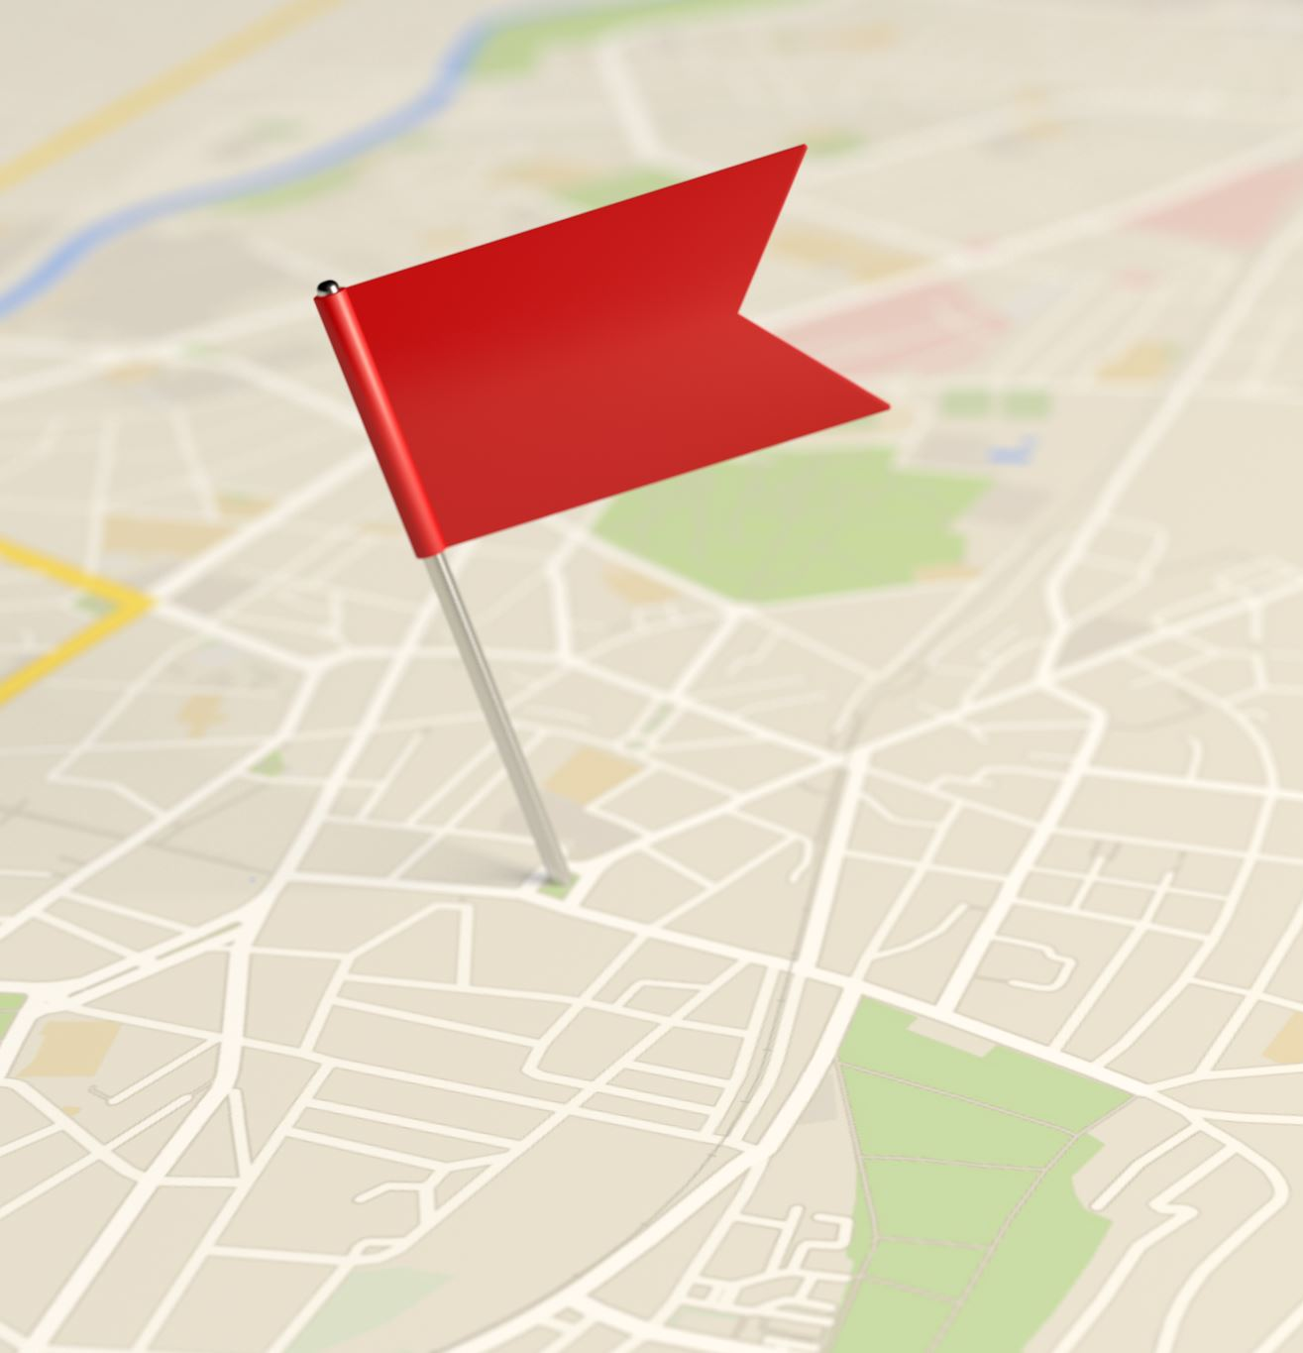
REFERENCES
https://github.com/codebasics/potato-disease-classification/blob/main/training/potato-disease-classification-model.ipynb
https://www.kaggle.com/datasets/arjuntejaswi/plant-village
https://www.mdpi.com/2073-4395/12/10/2395#:~:text=With%20the%20advent%20of%20machine,original%20characteristics%20of%20an%20image.
https://plantmethods.biomedcentral.com/articles/10.1186/s13007-021-00722-9

Slide 15

Thank you

